Slide 1
this
I am who I am

Slide 2
Objects
Objects are individual customized constructs built from templates.

Slide 3
Templates
A template defines the structure for the object, what information it contains and what tasks it can perform.

Slide 4
Templates
The programmer codes the template (often called a class).

Slide 5
Templates
Every object made from the template is comprised of the same information, stored in variables, and can perform the same tasks, written as functions.

Slide 6
HTML Elements
An HTML Element object is built from an HTML Element template. All HTML Elements have certain properties and tasks in common, though the values may differ.

Slide 7
HTML Elements
Every <div> and <span> has an innerHTML. When you have an object created, you can refer to the innerHTML (or any other property) by using the dot (.) operator.
object.property

Slide 8
HTML Elements
When you need to refer to the object from inside the template, or a part of the template, you refer to the object as this.
this.property

Slide 9
Transitioning
In the transition file, we will explore 2 different ways to access the <p> elements and change their text from lowercase to capital and back again.

Slide 10
Transitioning
Please follow along with the slides, updating and testing your page as you go.

Slide 11

Transition – toggleCaps()
Let’s start with the toggleCaps() function, which will change the text in an element from lowercase to capital or vice versa.

Slide 12
Transition – toggleCaps()
We’ll use a simple algorithm:
Search the text for a capital E.
If a capital E exists in the text:
Convert the text to all lowercase.
Else
Convert the text to all uppercase.

Slide 13
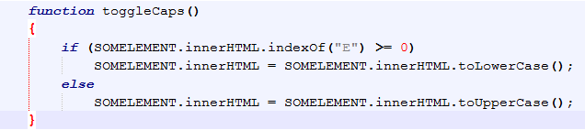
Transition – toggleCaps()
SOMELEMENT is the <p> element whose text is being changed.

Slide 14
Transition – toggleCaps()
The question is, when this function is called, which of the 3 <p> elements is SOMELEMENT?

Slide 15

Transition – Working with id
Starting with the familiar, let’s assign each element an id.

Slide 16
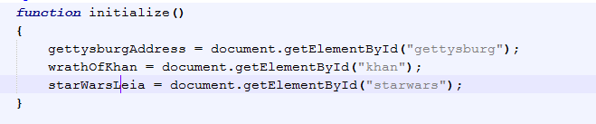

Transition – Working with ID
We can use this id to create objects in an initialize() function.

Slide 17
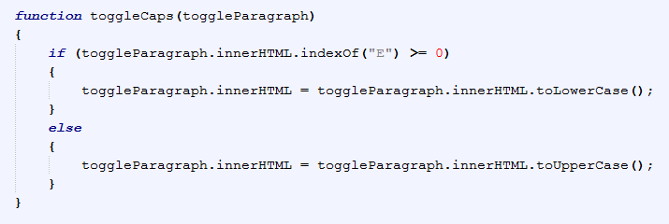
Transition – Working with ID
We can now begin to consider where SOMELEMENT is going to come from. Without prior knowledge regarding which element is clicked, we should create a parameter.

Slide 18
Transition – Working with ID
That parameter replaces SOMELEMENT everywhere in the function.

Slide 19
Transition – Working with ID
We populate that parameter with a value when we call the function. Since the function is click-activated, the call goes into an onclick and the value passed is the object we made that matches the <p> element.

Slide 20
Transition – Working with ID
This method globalizes the elements and is very useful in many cases. In something like this, however, there’s no need for the global variable when we can use this.

Slide 21
Transition – Working with this
Notice that we have replaced the global object in the argument list with this.

Slide 22
Transition – Working with this
Because this is inside the <p> element, it references the <p> the object.

Slide 23
Transition – Working with this
It can be used in any element to reference that specific element.

Slide 24
Transition – Working with this
You can now eliminate the ids and the global variables as they are no longer necessary for this page.
This does not mean you will never need ids and global variables again. You just don’t need them here.

Slide 25
Transition – Working with this
Go ahead and empty out initialize and remove the ids.
Does your page still work?
As for help if it doesn’t.

Slide 26
Practice
Included with this powerpoint is a group of images. Create an image gallery.
Your image gallery will include one large image and a row of “thumbnails”, one for each of the included images.
When the user clicks on a thumbnail, the large image will show the larger version of the selected thumbnail.
Do not create ids for each of the images. Use this to make the page work.

